Slide 1
File handling in C++

Slide 2
Using Input/Output Files
Files in C++ are interpreted as a sequence of bytes stored on some storage media.
The data of a file is stored in either readable form or in binary code called as text file or binary file.
The flow of data from any source to a sink is called as a stream
Computer programs are associated to work with files as it helps in storing data & information permanently.
File - itself a bunch of bytes stored on some storage devices.
In C++ this is achieved through a component header file called fstream.h
The I/O library manages two aspects- as interface and for transfer of data.
The library predefine a set of operations for all file related handling through certain classes.

Slide 3
Using Input/Output Files
A computer file
  is stored on a secondary storage device (e.g., disk);
  is permanent;
  can be used to provide input data to a program or receive output data from a program, or both;
  must be opened before it is used.

Slide 4
General File I/O Steps
Declare a file name variable
Associate the file name variable with the disk file name
Open the file
Use the file
Close the file

Slide 5
Using Input/Output Files
Streams act as an interface between files and programs. In C++ . A stream is used to refer to the flow of data from a particular device to the program’s variablesThe device here refers to files, keyboard, console, memory arrays. In C++ these streams are treated as objects to support consistent access interface.
They represent as a sequence of bytes and deals with the flow of data.
Every stream is associated with a class having member functions and operations for a particular kind of data flow.
File -> Program ( Input stream) - reads
Program -> File (Output stream) – write
All designed into fstream.h and hence needs to be included in all file handling programs.
Diagrammatically as shown in next slide

Slide 6
write data
to file
DISK FILE
read data
from file
Output Stream
Input Stream
data output
PROGRAM
data input

Slide 7
Using Input/Output Files
stream - a sequence of characters
  interactive (iostream)
    • cin - input stream associated with keyboard.
    • cout - output stream associated with display.
  file (fstream)
    • ifstream - defines new input stream (normally associated with a file).
    • ofstream - defines new output stream (normally associated with a file).
Stream of bytes to do input and output to different devices.
Stream is the basic concepts which can be attached to files, strings, console and other devices.
User can also create their own stream to cater specific device or user defined class.

Slide 8
Streams
A stream is a series of bytes, which act either as a source from which data can be extracted or as a destination to which the output can be sent. Streams resemble the producer and consumer model
The producer produces the items to be consumed by the consumer. The producer and the consumers are connected by the C++ operators >> or <<. For instance , the keyboard exhibits the nature of only a producer,printer or monitor screen exhibit the nature of only a consumer. Whereas , a file stored on the disk , can behave as a producer or consumer, depending upon the operation initiated on it.

Slide 9
Predefined console streams
C++ contains several predefined streams that are opened automatically when the execution of a program starts.
cin :standard input (usually keyboard) corresponding to stdio in C
2) cout :standard output (usually screen) corresponding to stdout in C
3) cerr :standard error output (usually screen) corresponding to stderr in C
4) clog : A fully buffered version of cerr (No C equivalent)

Slide 10
Why to use Files
Convenient way to deal large quantities of data.
Store data permanently (until file is deleted).
Avoid typing data into program multiple times.
Share data between programs.
We need to know:
how to "connect" file to program
how to tell the program to read data
how to tell the program to write data
error checking and handling EOF

Slide 11
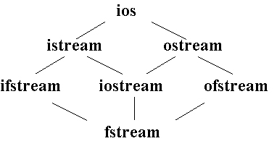
Classes for Stream I/O in C++
When working with files in C++, the following classes can be used:
ofstream – writing to a file
ifstream – reading for a file
fstream – reading / writing
When ever we include <iostream.h>, an ostream object, is automatically defined – this object is cout.
ofstream inherits from the class ostream (standard output class).
ostream overloaded the operator >> for standard output.…thus an ofstream object can use methods and operators defined in ostream.
ios is the base class.
istream and ostream inherit from ios
ifstream inherits from istream (and ios)
ofstream inherits from ostream (and ios)
iostream inherits from istream and ostream (& ios)
fstream inherits from ifstream, iostream, and ofstream

Slide 12
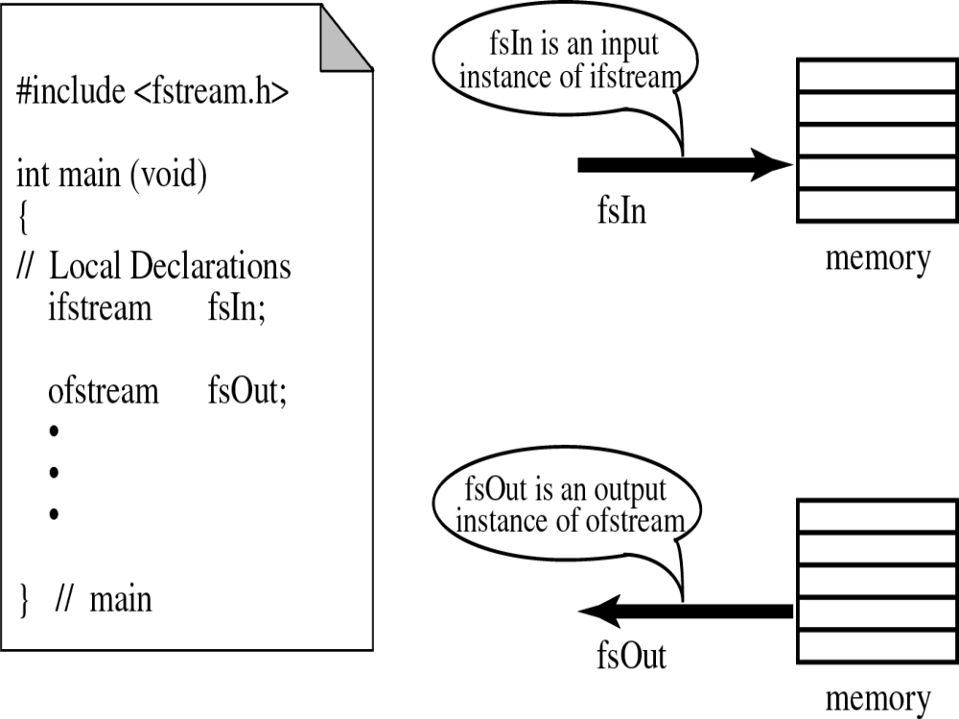

Slide 13
File Modes
Name | Description
ios::in | Open file to read
ios::out | Open file to write
ios::app | All the date you write, is put at the end of the file. It calls ios::out
ios::ate | All the date you write, is put at the end of the file. It does not call ios::out
ios::trunc | Deletes all previous content in the file. (empties the file)
ios::nocreate | If the file does not exist, opening it with the open() function gets impossible.
ios::noreplace | If the file exists, trying to open it with the open() function, returns an error.
ios::binary | Opens the file in binary mode.

Slide 14
File Modes
Opening a file in ios::out mode also opens it in the ios::trunc mode by default. That is, if the file already exists, it is truncated
Both ios::app and ios::ate set the pointers to the end of file, but they differ in terms of the types of operations permitted on a file. The ios::app allows to add data from end of file, whereas ios::ate mode allows to add or modify the existing data anywhere in the file. In both the cases the file is created if it is non existent.
The mode ios::app can be used only with output files
The stream classes ifstream and ofstream open files in read and write modes by default.

Slide 15
File pointers
Each file has two associated pointers known as the file pointers.
One of them is called the input pointer or get pointer.
The get pointer specifies a location from which the current reading operation is initiated
Other is called the output pointer or put pointer.
The put pointer specifies a location from where the current writing operation is initiated
We can use these pointers to move through the files while reading or writing.
The input pointer is used for reading the contents of a given file location and the output pointer is used for writing to a given file location.
Functions for manipulation of file pointers
seekg() Moves get pointer (input) to a specified location.
seekp() Moves put pointer (output) to a specified location.
tellg() Gives the current position of the get pointer.
tellp() Gives the current position of the put pointer.

Slide 16
File pointers
infile.seekg(10);
Moves the file pointer to the byte number 10.
The bytes in a file are numbered beginning from zero. Thus, the pointer will be pointing to the 11th byte in the file.
Specifying the offset :
The seek functions seekg() and seekp() can also be used with two arguments as follows:
seekg(offset, refposition);
seekp(offset, refposition);
The parameter offset represents the number of bytes the file pointer to be moved from the location specified by the parameter refposition.
The refposition takes one of the following these constant defined in the ios class.
ios::beg start of the file
ios::cur current position of the pointer
ios::end end of the file.

Slide 17
File Open Mode
#include <fstream>
int main(void)
{
ofstream outFile("file1.txt", ios::out);
outFile << "That's new!\n";
outFile.close();
Return 0;
}
If you want to set more than one open mode, just use the OR operator- |. This way:
ios::ate | ios::binary

Slide 18
Dealing with Binary files
Functions for binary file handling
get(): read a byte and point to the next byte to read
put(): write a byte and point to the next location for write
read(): block reading
write(): block writing
flush():Save data from the buffer to the output file.

Slide 19
Binary File I/O Examples
//Example 1: Using get() and put()
#include <iostream>
#include <fstream>
void main()
{
fstream File("test_file",ios::out | ios::in | ios::binary);
char ch;
ch='o';
File.put(ch); //put the content of ch to the file
File.seekg(ios::beg); //go to the beginning of the file
File.get(ch); //read one character
cout << ch << endl; //display it
File.close();
}

Slide 20
File I/O Example: Writing
#include <fstream>
using namespace std;
int main(void)
{
ofstream outFile(“fout.txt");
outFile << "Hello World!";
outFile.close();
return 0;
}

Slide 21
File I/O Example: Reading
#include <iostream>
#include <fstream>
int main(void)
{
ifstream openFile(“data.txt"); //open a text file data.txt
char ch;
while(!OpenFile.eof())
{
OpenFile.get(ch);
cout << ch;
}
OpenFile.close();
return 0;
}

Slide 22
File I/O Example: Reading
#include <iostream>
#include <fstream>
#include <string>
int main(void)
{
ifstream openFile(“data.txt"); //open a text file data.txt
string line;
if(openFile.is_open()){ //
while(!openFile.eof()){
getline(openFile,line);//read a line from data.txt and put it in a string
cout << line;
}
else{
cout<<“File does not exist!”<<endl;
exit(1);}
}
openFile.close();
return 0;
}

Slide 23
To access file handling routines:
#include <fstream.h>
2: To declare variables that can be used to access file:
ifstream in_stream;
ofstream out_stream;
3: To connect your program's variable (its internal name) to an external file (i.e., on the Unix file system):
in_stream.open("infile.dat");
out_stream.open("outfile.dat");
4: To see if the file opened successfully:
if (in_stream.fail())
{ cout << "Input file open failed\n";
exit(1); // requires <stdlib.h>}

Slide 24
To get data from a file (one option), must declare a variable to hold the data and then read it using the extraction operator:
int num;
in_stream >> num;
[Compare: cin >> num;]
6: To put data into a file, use insertion operator:
out_stream << num;
[Compare: cout << num;]
NOTE: Streams are sequential – data is read and written in order – generally can't back up.
7: When done with the file:
in_stream.close();
out_stream.close();

Slide 25
Reading /Writing from/to Binary Files
To write n bytes:
write (const unsigned char* buffer, int n);
To read n bytes (to a pre-allocated buffer):
read (unsighed char* buffer, int num)
#include <fstream.h>
main()
{
int array[] = {10,23,3,7,9,11,253};
ofstream OutBinaryFile("my_b_file.txt“, ios::out | ios::binary);
OutBinaryFile.write((char*) array, sizeof(array));
OutBinaryFile.close();
}

Slide 26
C++ has some low-level facilities for character I/O.
char next1, next2, next3;
cin.get(next1);
Gets the next character from the keyboard. Does not skip over blanks or newline (\n). Can check for newline (next == '\n')
Example:
  cin.get(next1);
  cin.get(next2);
  cin.get(next3);
Predefined character functions must #include <ctype.h> and can be used to
    convert between upper and lower case
    test whether in upper or lower case
    test whether alphabetic character or digit
    test for space

Slide 27
Reading /Writing from/to Textual Files
#include <fstream.h>
main()
{
// Writing to file
ofstream OutFile("my_file.txt");
OutFile<<"Hello "<<5<<endl;
OutFile.close();
int number;
char dummy[15];
// Reading from file
ifstream InFile("my_file.txt");
InFile>>dummy>>number;
InFile.seekg(0);
InFile.getline(dummy,sizeof(dummy));
InFile.close();
}
To write:
  put() – writing single character
  << operator – writing an object
To read:
  get() – reading a single character of a buffer
  getline() – reading a single line
  >> operator – reading a object

Slide 28
Binary file operations
In connection with a binary file, the file mode must contain the ios::binary mode along with other mode(s)
To read & write a or on to a binary file,
as the case may be blocks of data are accessed through
the use of C++ read() and write() respectively.

Slide 29
Handling binary data
#include <fstream>
using namespace std;
int main(){
ifstream in(“binfile.dat”);
ofstream out(“out.dat”);
if(!in || !out) { // return}
unsigned int buf[1024];
while(!in){
in.read(buf, sizeof(unsigned int)*1024);
out.write(buf, sizeof(unsigned int)*1024);
}

